Slide 1
SQL Server 2008
Step by Step Installation

Slide 2
Download SQL Server 2008 r2 express
https://www.microsoft.com/en-pk/download/details.aspx?id=30438

Slide 3
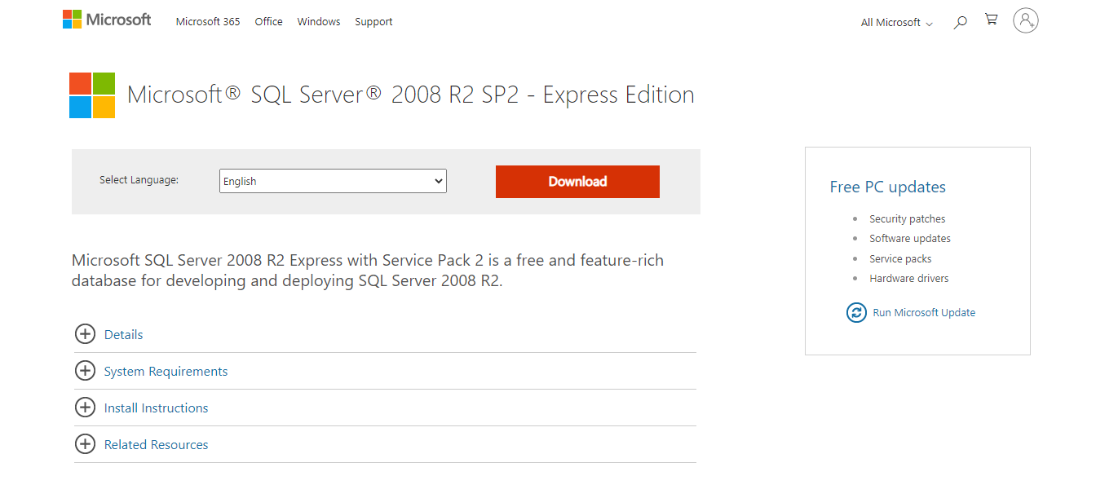
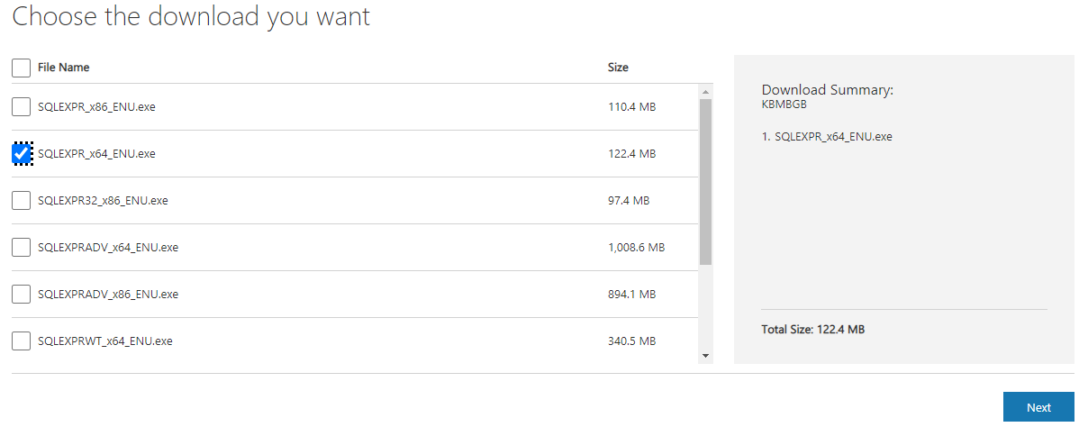
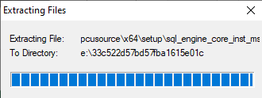

Slide 4
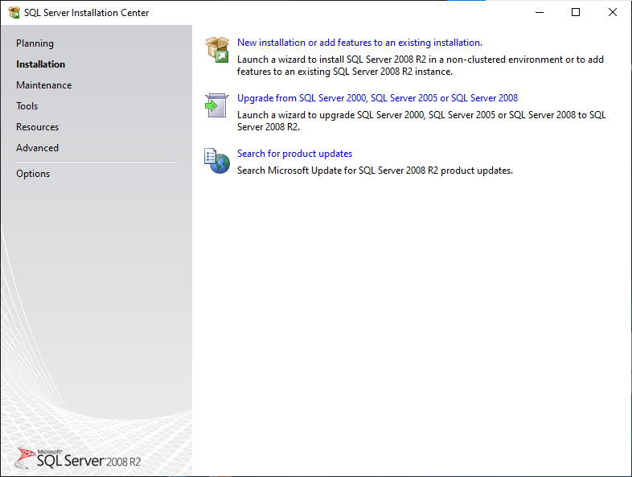
Click on new installation

Slide 5
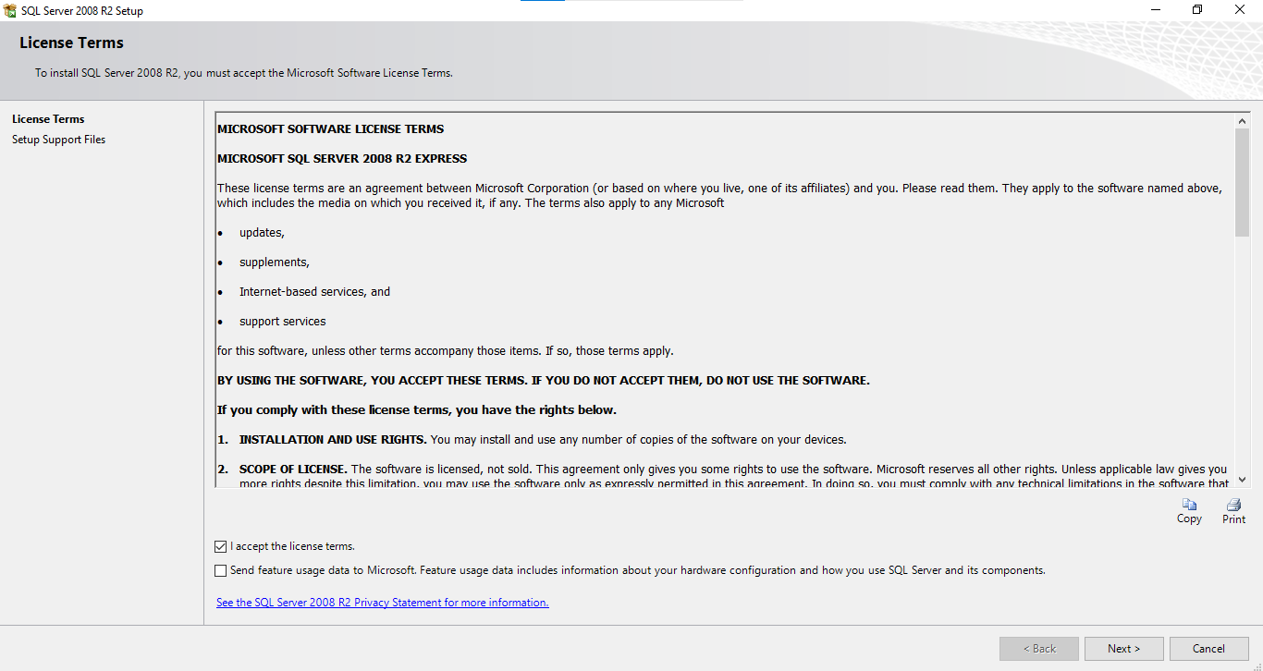
Click on I accept license terms & Next

Slide 6
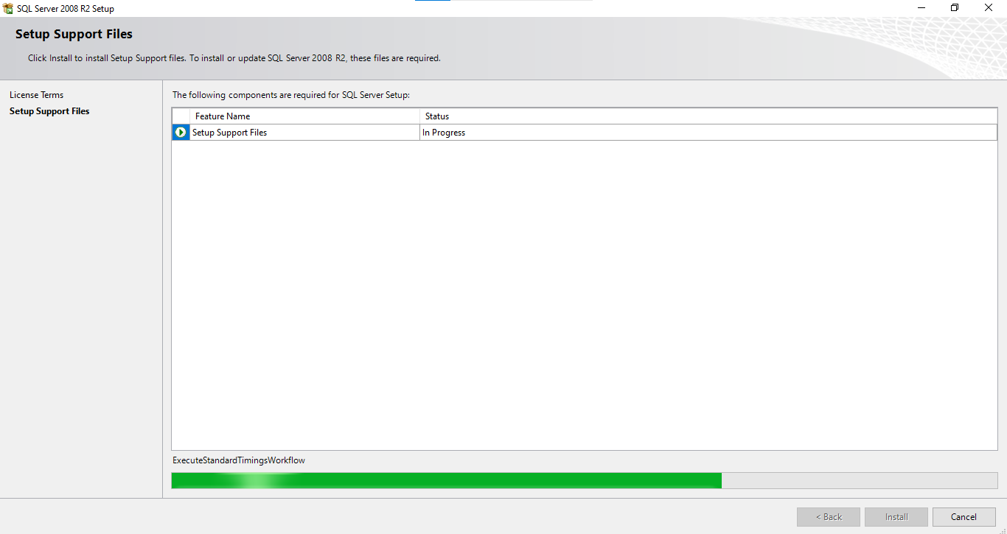

Slide 7
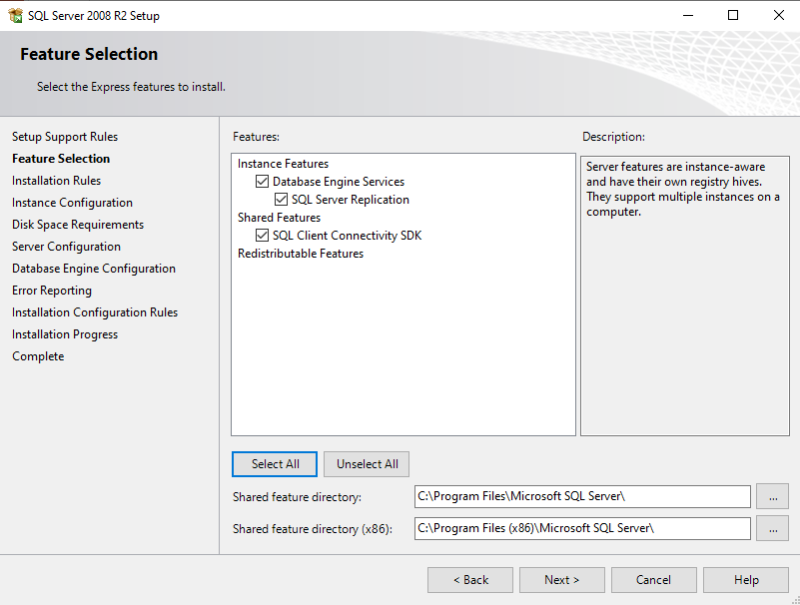
Click Select All button & then the Next button

Slide 8
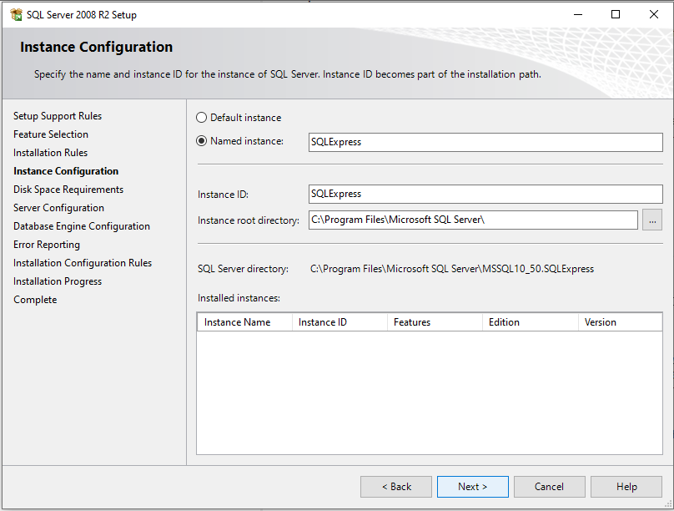
C:\Program Files\Microsoft SQL Server\

Slide 9
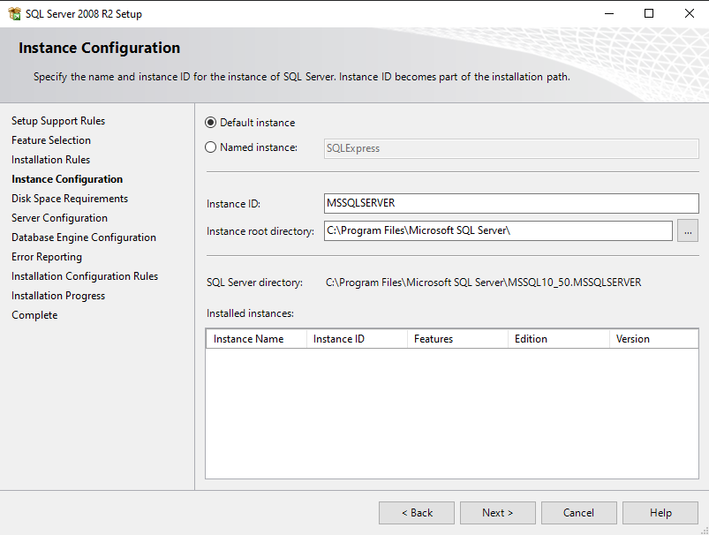

Slide 10
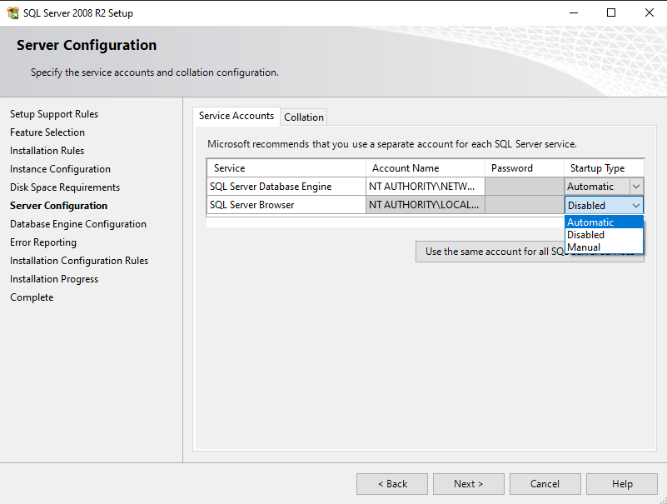

Slide 11
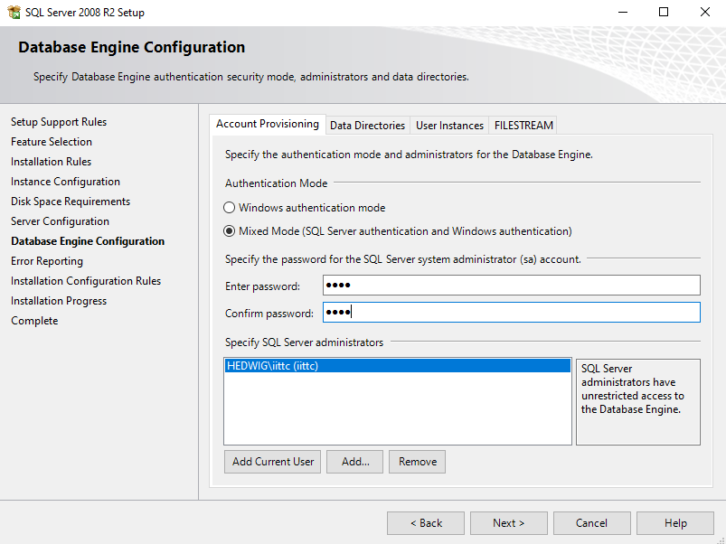

Slide 12
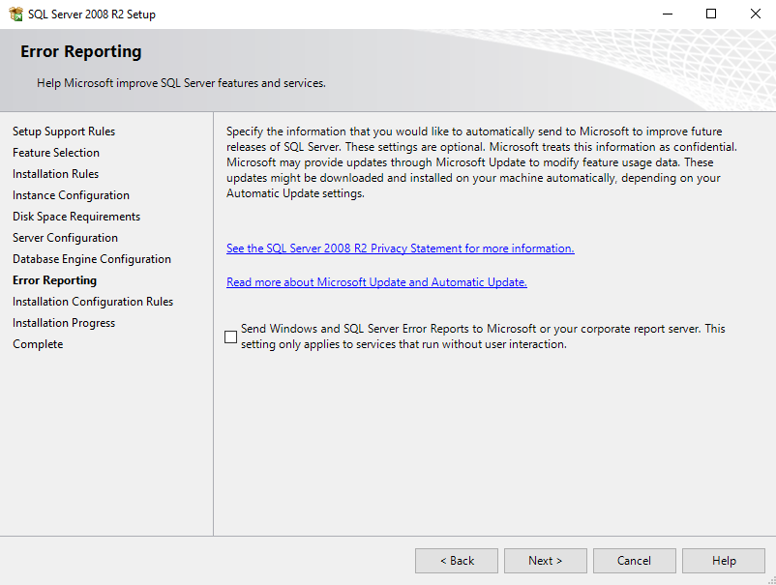

Slide 13
